Slide 1
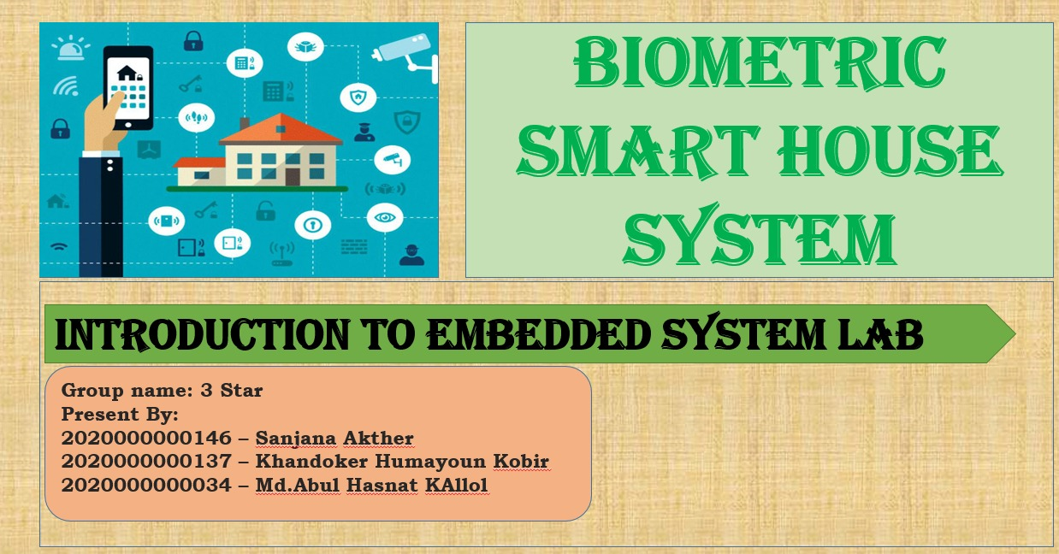

Slide 2
INTRODUCTION:
a biometric smart house system using an Arduino board and a fingerprint sensor. The system aims to provide secure access control to the house through fingerprint recognition and incorporate occupancy detection for enhanced automation.

Slide 3
COMPONENTS: (Hardware based)
Fingerprint sensor: Capture and store fingerprint data
Display: Show relevant information
Servo motor: Control the door mechanism
Motion sensor: Detect presence in the house
LEDs: Indicate occupancy status
COMPONENTS: (Hardware based)
Database: Store authorized fingerprint information and associated data

Slide 4
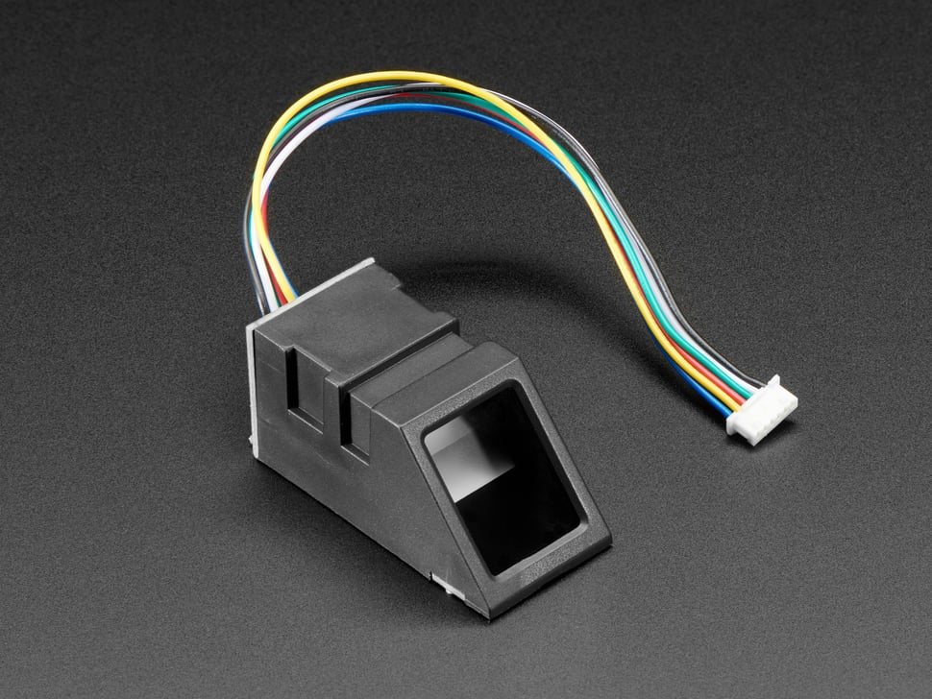
FRINGERPRINT ENTROLLMENT:
Model:ZA620_M5
4 pin: vcc,ground,tx,rx
Green light indicates waiting for input.
Connected with Arduino
Use the fingerprint sensor for image
Store it in database

Slide 5
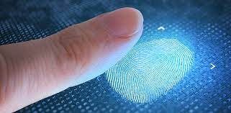
Fingerprint Verification
1.Check data
3.compare
2.Capture image
4.Matched sample proceed

Slide 6

Door Control: (servo SG90)
OPEN
Verified fingerprint matched.
After entrance of selected one
CLOSE
…..

Slide 7
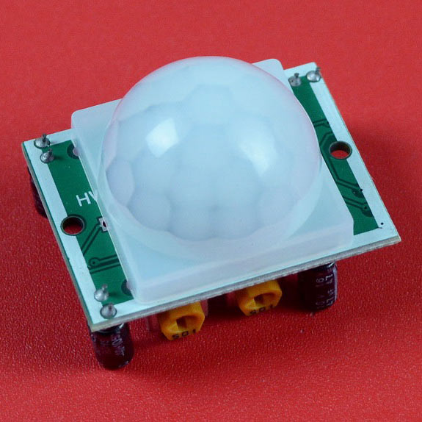
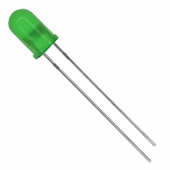
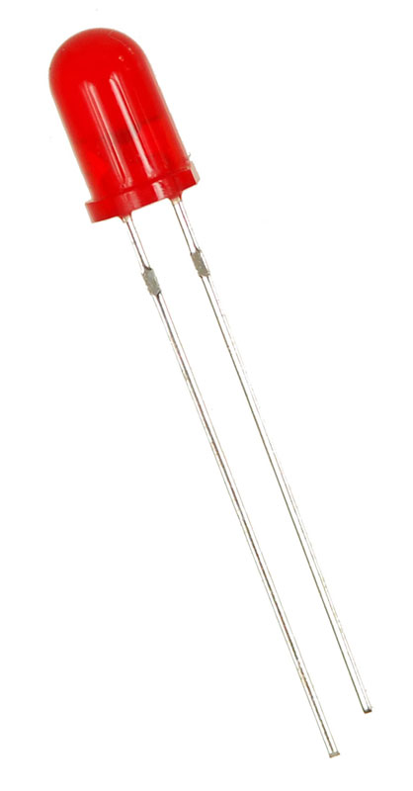
OCCUPANCY DETECTION:
PIR MOTION SENSOR
Green LED:
Detect the presence in the house
Illuminate green led ,if the house is occupied
Red LED:
Illuminates red light ,if the house is unoccupied

Slide 8
Security and Benefits:
Security increased as biometric authentication.
Unauthorized access prevented
Real time monitoring and control

Slide 9
Future Work:
1. cloud-based database:
3. Advanced security features:
2. Multiple user support
4. User interface improvements:

Slide 10
CONCLUSION:
The implementation allowed users to enroll their fingerprints and verify their identity to gain access to the house. The system accurately detected occupancy using the motion sensor and adjusted the behavior accordingly.

Slide 11
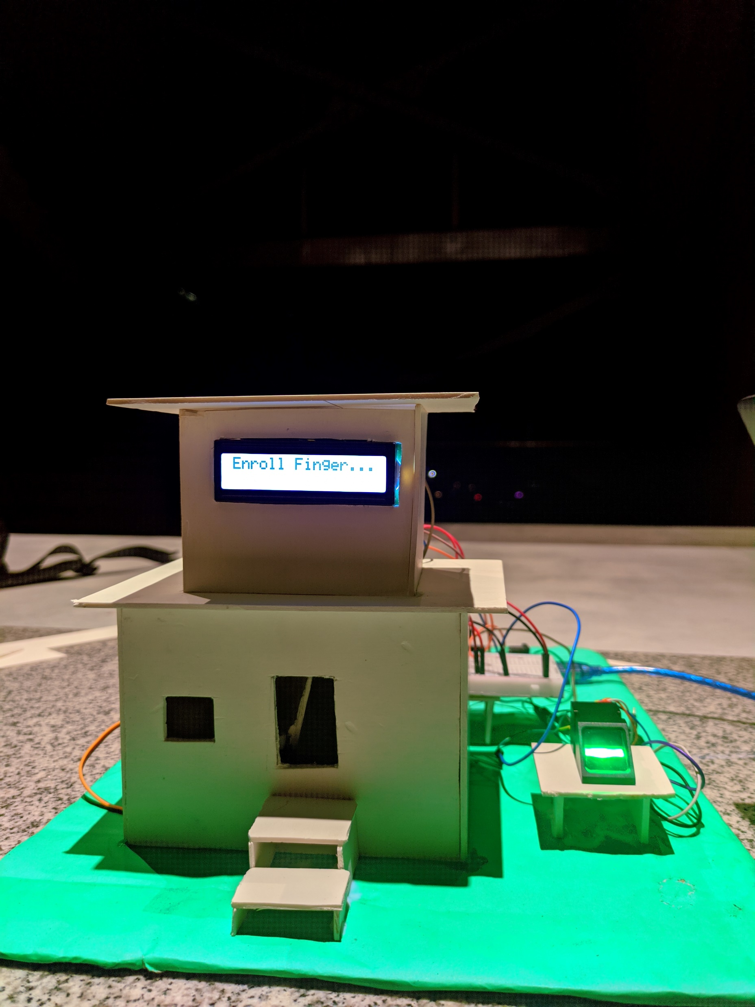
DIAGRAM:

Slide 12
THANK YOU ☺

